Slide 1
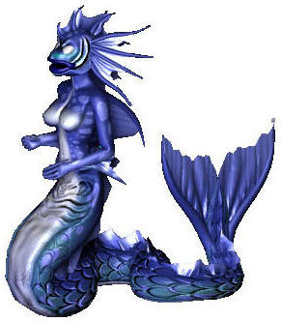
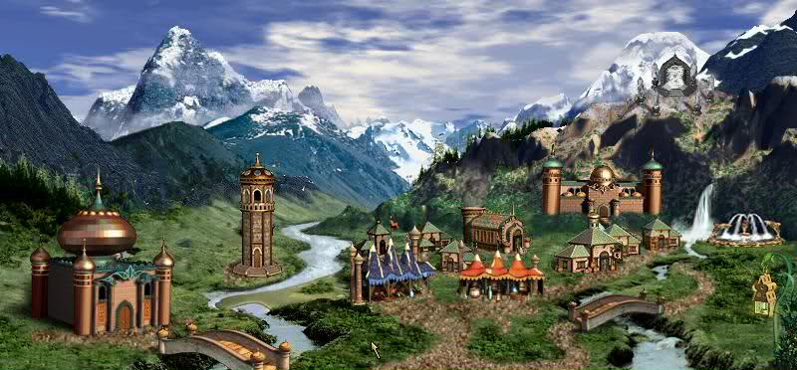
TEAM
ICE ELEMENTAL

Slide 2
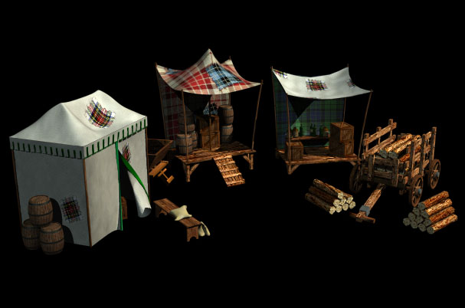
Someone has to provide furniture for the Empire, because war takes its toll…

Slide 3

So an enterprising Ice Elemental decided to create a furniture system to faciliate furniture orders, get paid tons of gold and hopefully travel away from everyone that can cast a Fire Magic spell.

Slide 4
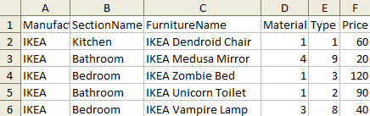
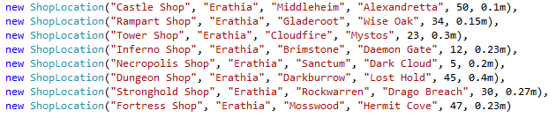
He hired a few Psychic Elementals and contacted the most renowned furniture manufacturers and dealers in Erathia…

Slide 5
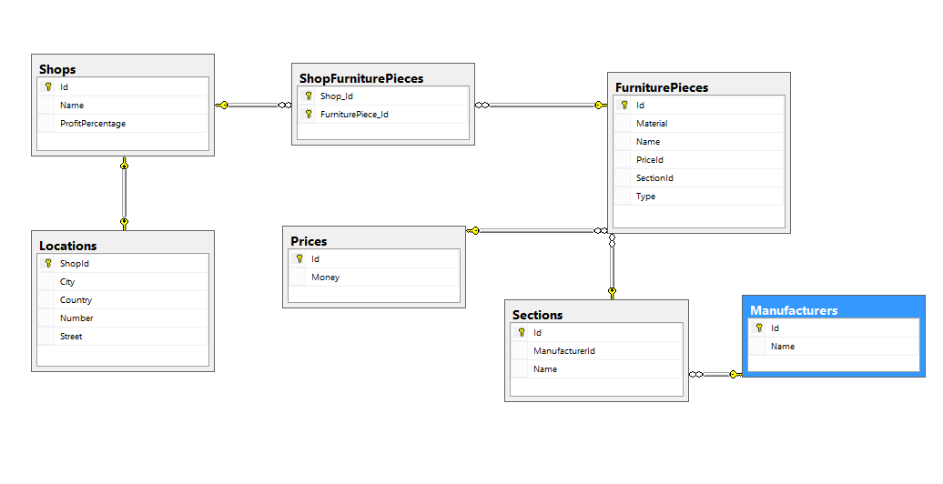
… and gathered them in the
OFCE System
/Outstanding Furniture Consortium of Erathia/

Slide 6
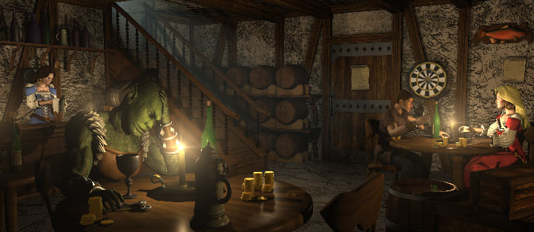
Now all generals can easily buy chairs, so their troops can drink ale in the taverns / except for the Angels, who don’t drink/.

Slide 7
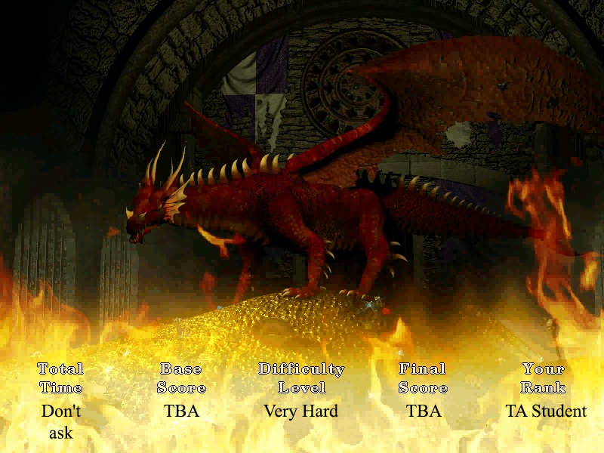
Happy End!

